Slide 1
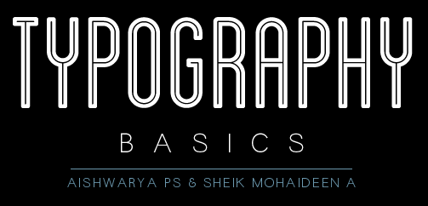

Slide 2

Introduction
History of typo
What is typography
Basics of Typography
Why typo is essential in design
Typeface Vs. Fonts
Principles of typography
Font Families & Type
Understanding typo requirements
Font combinations
Rules & Best practices
Mood & Usage
Posters & Designs using typo
Top Fonts
Brand guidelines & Style guides
Cognizant’s font usage
Useful links
Activities & Feedback

Slide 3


Introduction
Grids
The diagram above is intended to show in a basic way how different pieces of type can be positioned on a grid, and what the main parts of a grid are called.

Slide 4
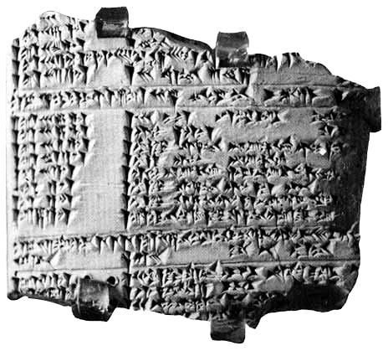
History of Typography
Sumerians
First written language based on abstract signs around 3000 B.C.E.
Imprints of the signs cuneiform,
pressing a wedge-shaped stylus into wet clay.

Slide 5
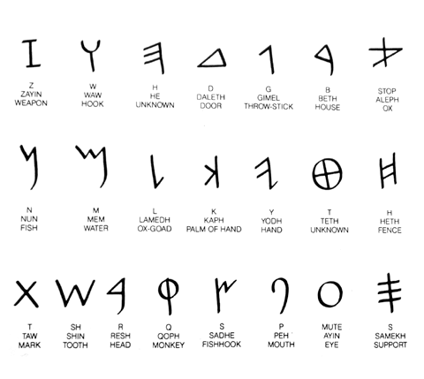
History of Typography
The Phoenician alphabet
Egypt origin
One sign represents one spoken sound.
22 consonants
Each sign is shown its sound value, name and meaning.
Reads from right to left.

Slide 6
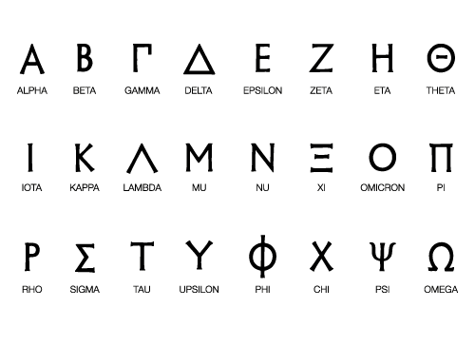
History of Typography
Adoption by Greek
Stone – engraved
Adopted from Phoenician
Added vowels to it
Greeks adopted and added vowels

Slide 7
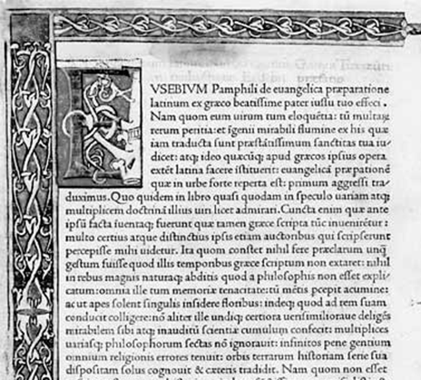
History of Typography
Nicholas Jensen (1420-1480)
He cut the first successful roman typeface in 1470.
The type was based on the formal Humanistic script.
Display initials and borders were hand painted.

Slide 8

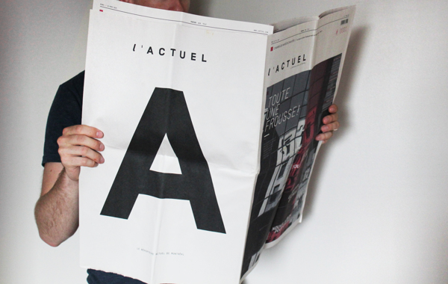

What is Typography

Slide 9
What is Typography
Typography is the art and technique of arranging type.
Its a central component of design. It gives us an understanding of the heritage behind our craft.
It’s one of the primary ways we, as a society, pass on information to others.
Because everything we touch, see and create is impacted by the use of writing styles and techniques.
Just imagine a website, a magazine or even TV without text.

Slide 10




What is Typography
Typefaces can contain a multitude of different symbols
LETTERS
NUMBERS
PUNCTUATIONS
SYMBOLS

Slide 11
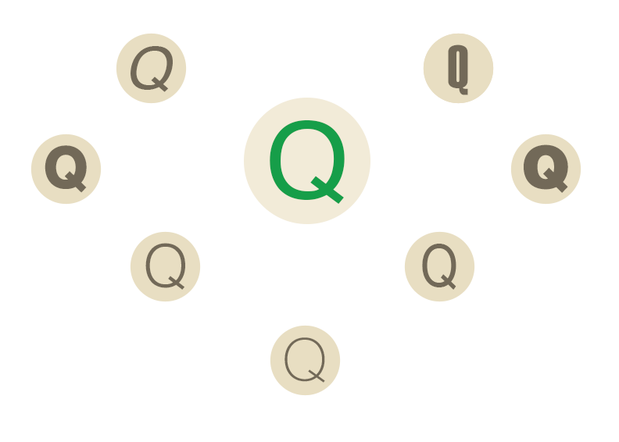
What is Typography
Common style of Typefaces
ITALIC
EXTRA CONDENSED
HEAVY
BLACK
LIGHT
NORMAL
NARROW
THIN

Slide 12
Typeface Vs Fonts
A typeface is a design created by a typographer or type designer.
Designers choose typefaces to create their projects. Each typeface is known by a name, such as Helvetica, Arial, Times New Roman, etc.
The term “typeface” originated from movable type, whose blocks of wood or metal each contain a relief image of a character on one surface (the “face”).

Slide 13
Typeface Vs Fonts
A font is the digital representation of a typeface.
It is a collection of all the characters of a typeface in one size (12pt/1in) and one style (bold/italic).
For example, Arial in 12pt size is a font, Arial in 18pt size is a font, and Arial bold in 24pt is also a font.
Adobe's type glossary lists a font as “one weight, width, and style of a typeface.”

Slide 14

Basics of Typography
Crossbar
Ascender
Cap Height
Stem
Axis
Eye
Serif
Terminal
ear
Shoulder
Bracket
Baseline
Bowl
Decender
Counter
Loop/Lobe
Tail
Link neck

Slide 15
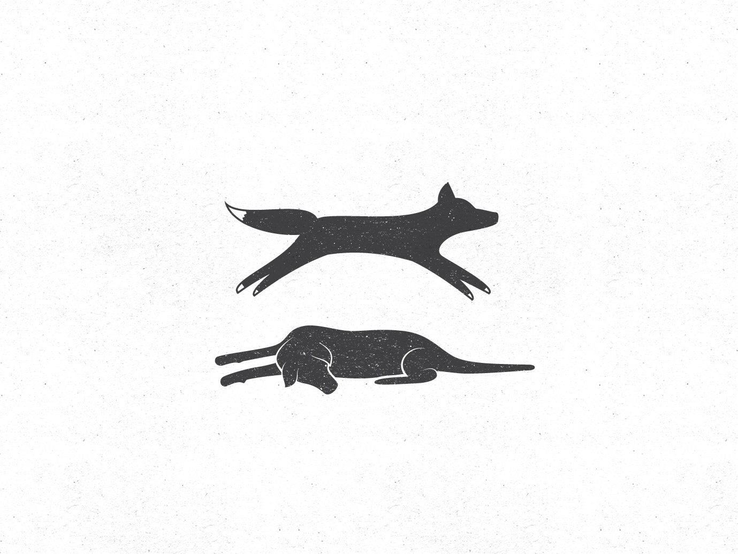
Paragram
The quick brown fox jumps over the lazy dog

Slide 16
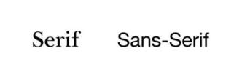
Font Families & Type
The most common two types you will hear of are:
Serif :
These typefaces are the more traditional ones. They are distinguished by a short line or finishing stroke on the end of character strokes and stems.
Sans-serif :
As the name suggests, these are distinguished by their lack of any Serifs. They only became popular in the nineteenth century and are considered modern as a result.

Slide 17
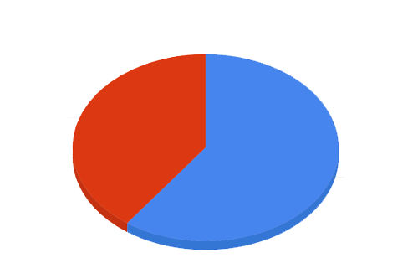
Font Families & Type
Serif & Sans Serif in Headlines & Body
Serif
40 %
Sans Serif
60 %
Easy to read and look great at a large size.
Only 34% of websites use a serif typeface for body copy

Slide 18
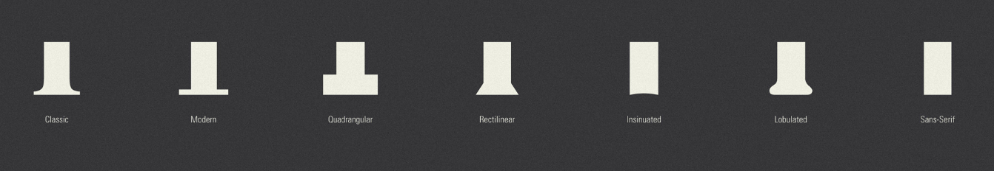
Font Families & Type
Serifs

Slide 19
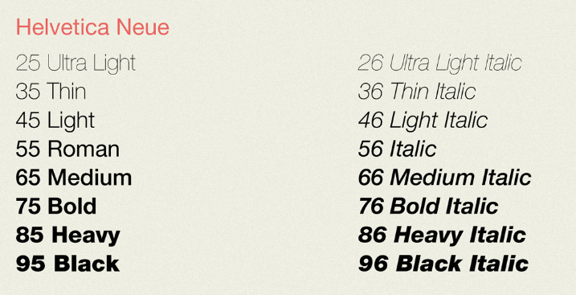
Font Families & Type
Weight

Slide 20
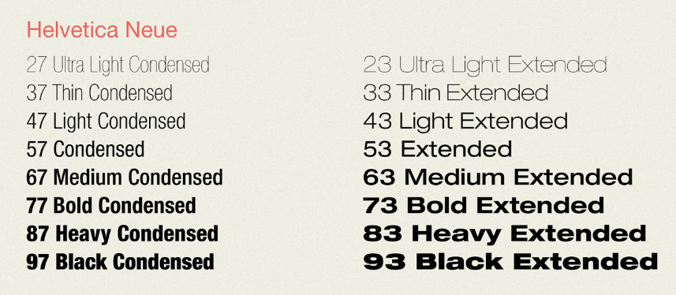
Font Families & Type
Width

Slide 21
Font Families & Type
Representation

Slide 22
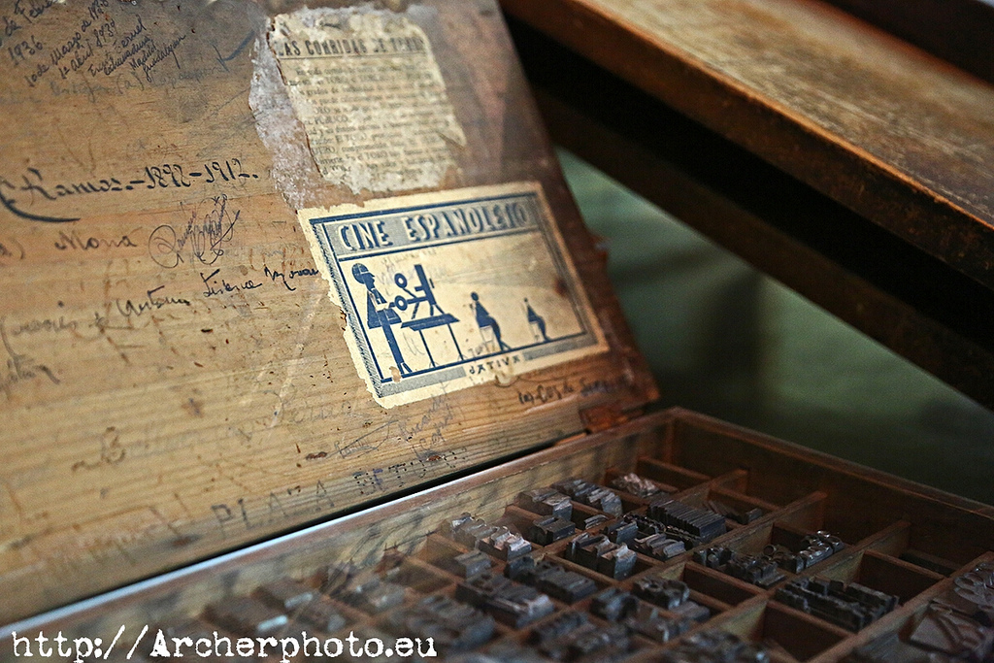
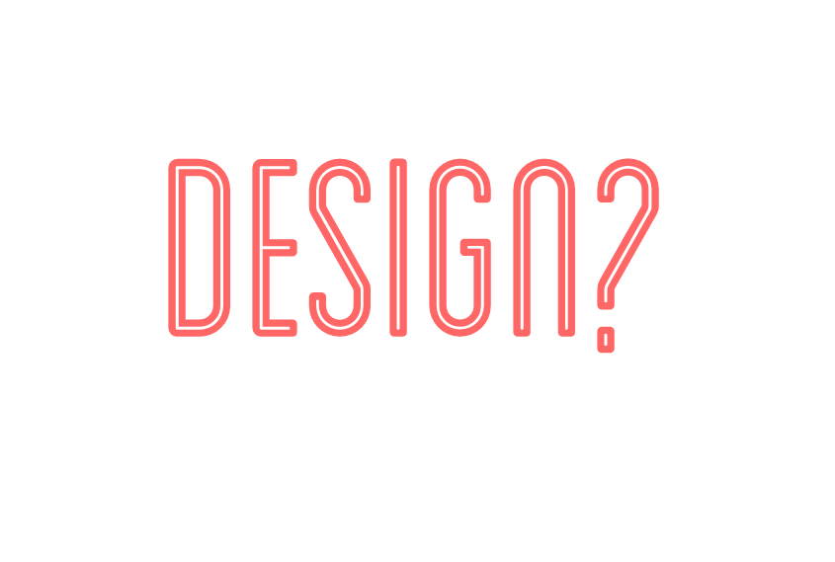
Why
Typography
is essential in

Slide 23
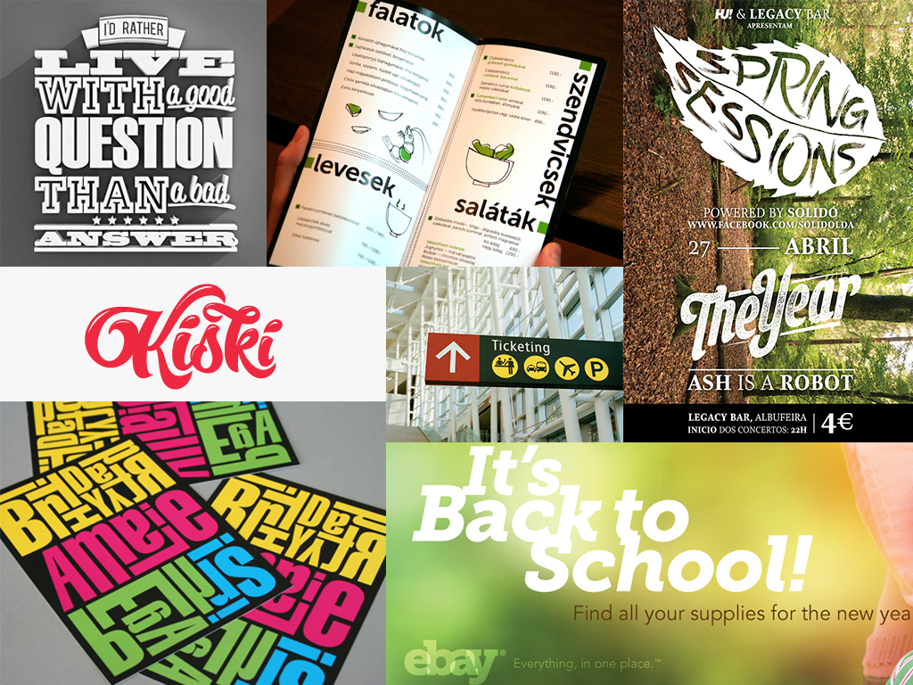

Slide 24
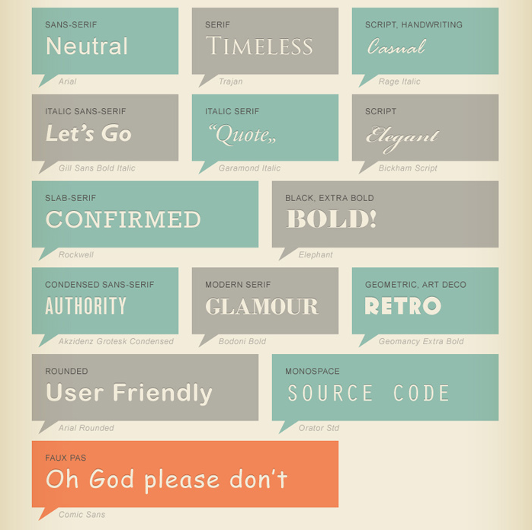
Why typography is essential in design
1. It conveys the feeling

Slide 25
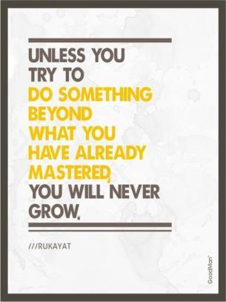

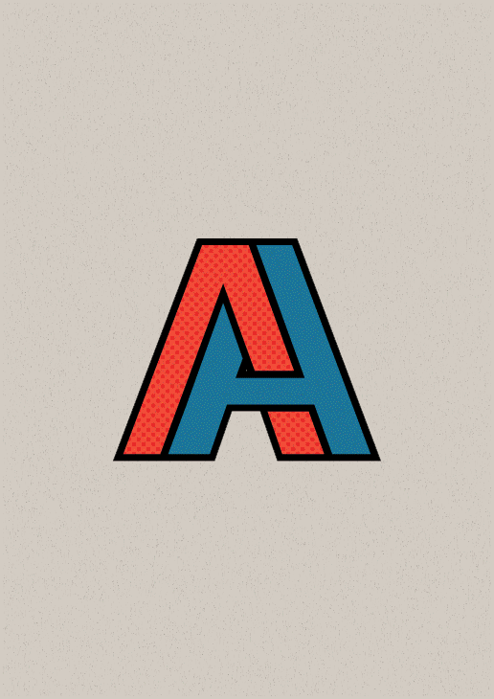
Why typography is essential in design
2. Keeps people Reading

Slide 26
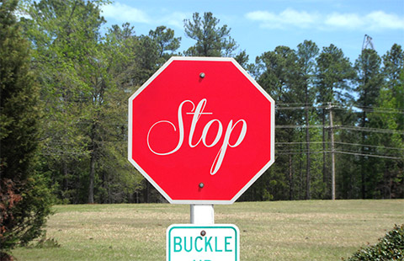

Why typography is essential in design
3. Communicates the tone of Voice

Slide 27
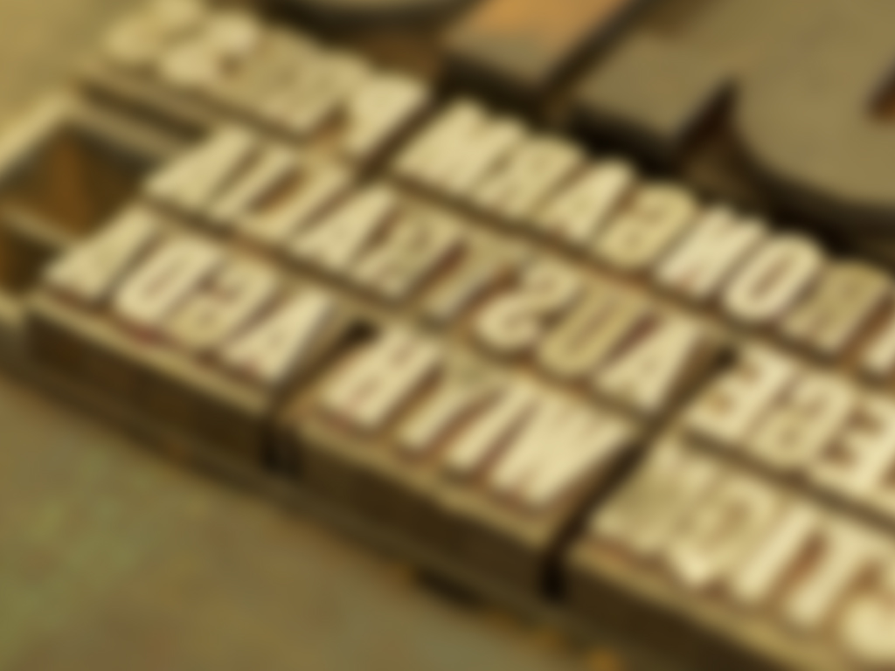


Slide 28


Principles of Typography
1. Font Size
Text on the Web has been too small for too long.
most type on the Web is set on the screen at 12px or lower.
However, we tend to use between 14 and 16 px for body copy as it is more scannable and better received on responsive design .
This is due to large monitors and crisp hi-definition screen resolutions on tablets and mobiles.

Slide 29
Principles of Typography
1. Consistency
You should decide on such settings as fonts, inter-paragraph spacing, the size of subheads and color usage.
Then create a written style guide to help you maintain these paradigm to other collaterals
In web development, this consistency must be followed and developed web screens to be compared with the visual designs to make sure its perfectly implemented.

Slide 30
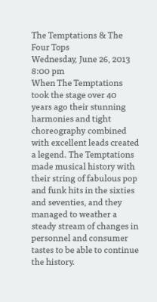
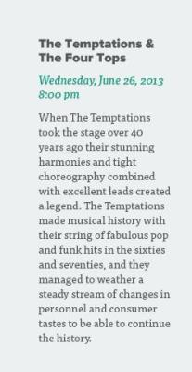
Principles of Typography
2. Hierarchy
When planning your design, it’s important to work out how you’re going to identify hierarchy and structure.
How big or how bold should the title/headline be? What about sub-headings, body copy or figure captions?
Achieving good hierarchy should generally start with a sketch where you layout what your most important visual element is down to your least important element.

Slide 31
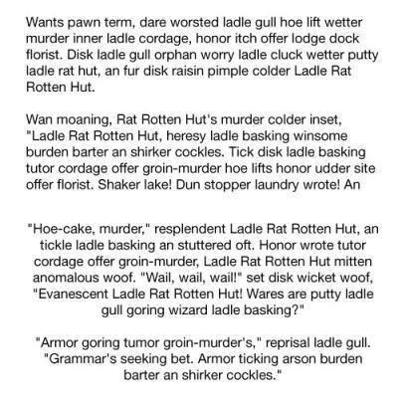
Principles of Typography
3. Alignment
Alignment is an extremely important concept in typography.
Non-designers tend to instinctively center align everything. Somewhere in life we learn that if something is centered then it is balanced and therefore better.
In reality, center alignment is the weakest, hardest to read alignment and should be used very selectively.

Slide 32
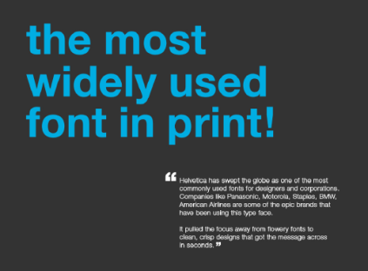
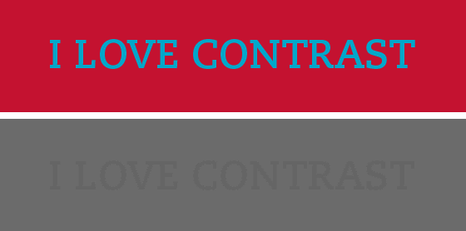
Principles of Typography
4. Color Contrast.
In the image below, even though the colors are very different, once they are converted to grey scale, you can see that their values are so close the words become almost impossible to read. This tells you these colors are not a good pair.

Slide 33
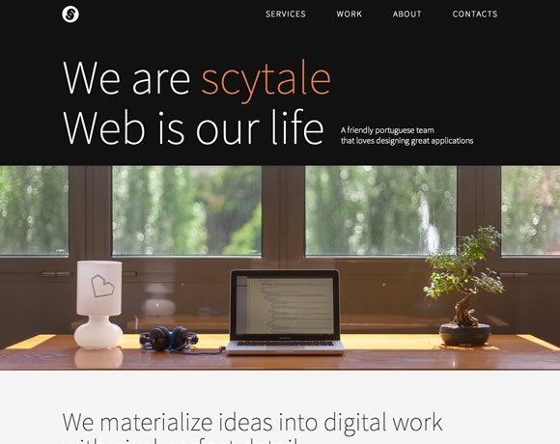
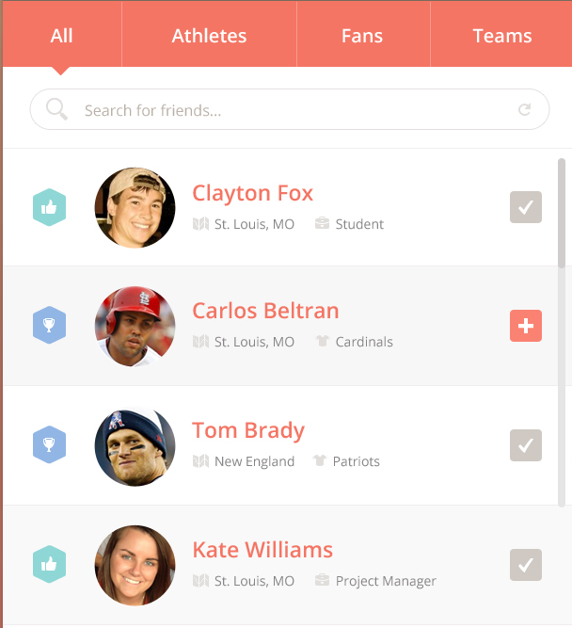
Principles of Typography
4. Color Contrast.

Slide 34
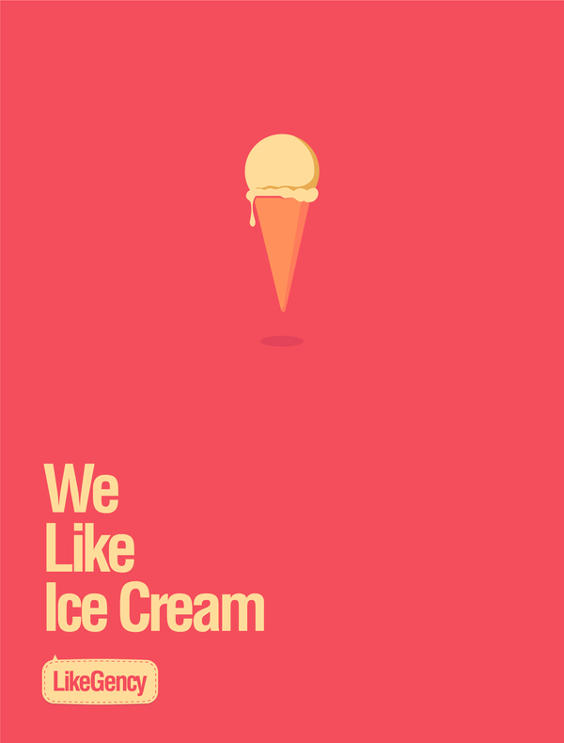
Principles of Typography
5. Whitespace
White space, or negative space, is the space between elements in a composition.
Whitespace can be used to create balance or lead the viewers eye from one part of the composition to the next.
It can invoke a feeling of elegance or add a level of communication to a typographic treatment.

Slide 35
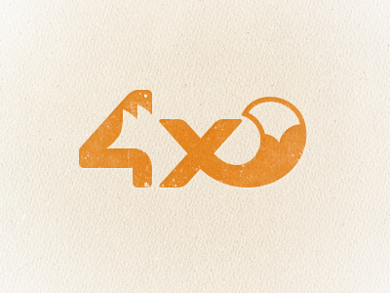


Principles of Typography
The FedEx logo uses the whitespace between the uppercase E and the x to create a counter form - an arrow.
This adds a secondary level of communication to the word.

Slide 36
Typography Rules & best Practices
Always spell check!
Insert only a single space after all punctuation
Use proper ‘em’ dashes, ‘en’ dashes, and hyphens
Use proper quote and apostrophe marks
Use caps properly whenever needed
Use copyright, register, and trademark marks properly
Avoid underlined text
Avoid letter spacing on lowercase body copy
Good color scheme makes better typo.
Use max of 3 fonts in one design, Not more than that.

Slide 37
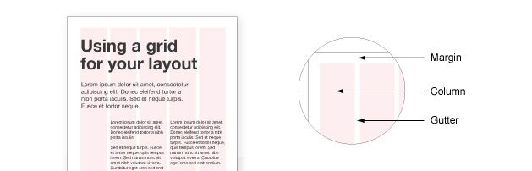
Elements of typography
Grids
The diagram above is intended to show in a basic way how different pieces of type can be positioned on a grid, and what the main parts of a grid are called.

Slide 38
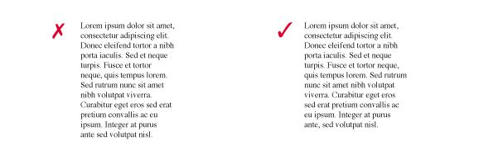
Elements of typography
Rag
This is the uneven vertical edge of a block of type, most commonly the right-hand edge, as in the case of left-aligned text. It is important to pay attention to the rag, as it can affect readability in a big way.
If the rag is not very good, it can be very distracting on the eye, as you read down a column. Usually it can easily be fixed by reworking the line breaks, or by editing the copy.

Slide 39
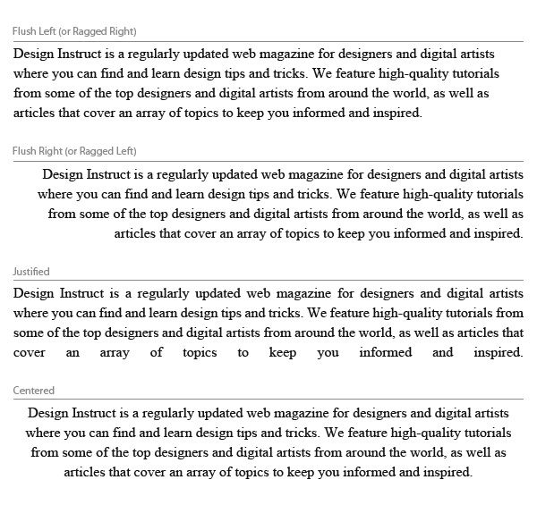
Elements of typography
Justified & Centered
Text is aligned to the center of the text area, rather than the edges.
Centered text looks best when there are only a few lines of text (2-3 lines).
Be sure that your text area is wide enough to break the text into logical lines and that there is enough contrast between the line length to make the text inviting.

Slide 40
Elements of typography
Justified & Centered
The start and end of text lines are both aligned to the left and right.
While justified alignment looks clean because it fits neatly into a box, it can also be hard to read because there is less visual cue between the termination of a text line.
Variances in spacing can appear between words in order to keep the lines even.

Slide 41
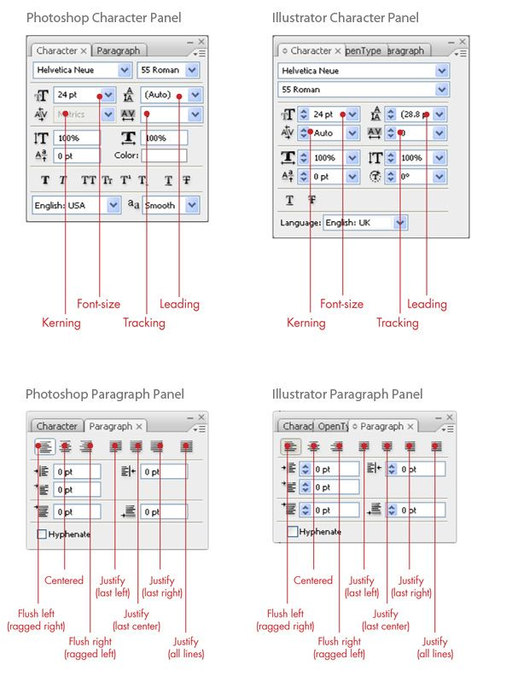
Elements of typography
Working with Typography in Photoshop and Illustrator
Graphics software such as Photoshop and Illustrator have powerful typesetting features. The concepts discussed above are all available to you in Photoshop and Illustrator.

Slide 42
Elements of typography
Working with Typography in Photoshop and Illustrator
These two panels that deal with typography are the Character Panel (Window > Character) and Paragraph Panel (Window > Paragraph).

Slide 43
Web fonts
The fonts that are most safe to use are:
Arial / Helvetica
Times New Roman / Times
Courier New / Courier
Other options that usually work cross-platform are:
Palatino
Garamond
Bookman
Avant Garde
Fonts that work on Windows and MacOS but not Unix+X are:
Verdana, Georgia, Comic Sans MS, Trebuchet MS, Arial Black
& Impact

Slide 44
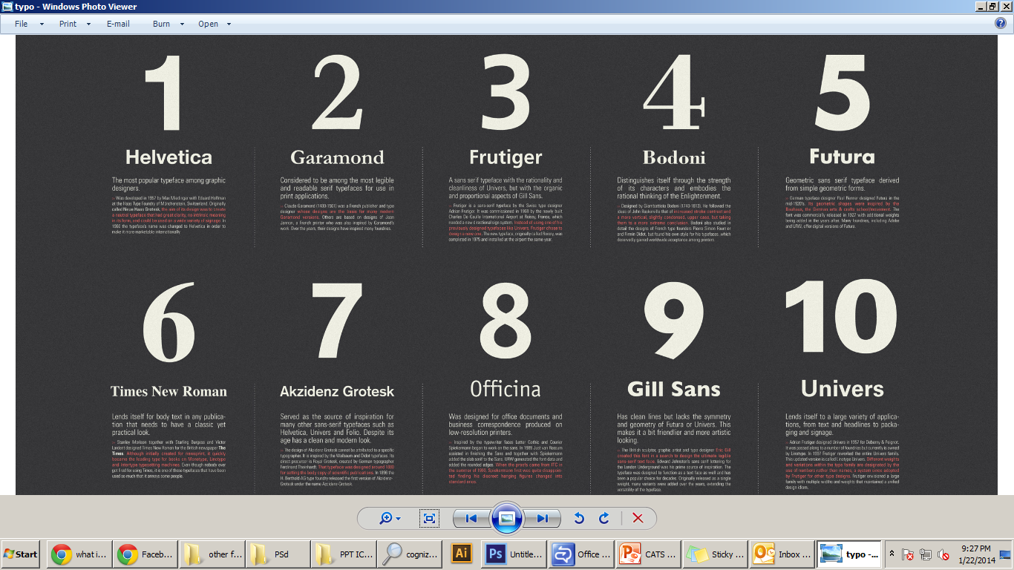
Top fonts

Slide 45
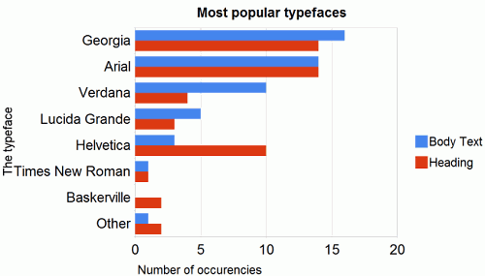
Most Popular Web fonts

Slide 46

Font Usage for Mobile
Font Size
Contrast
Spacing

Slide 47
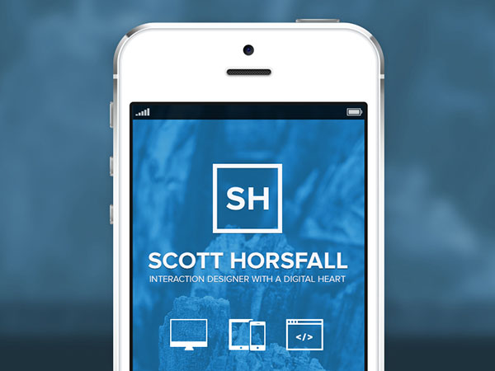
Font Usage for Mobile

Slide 48
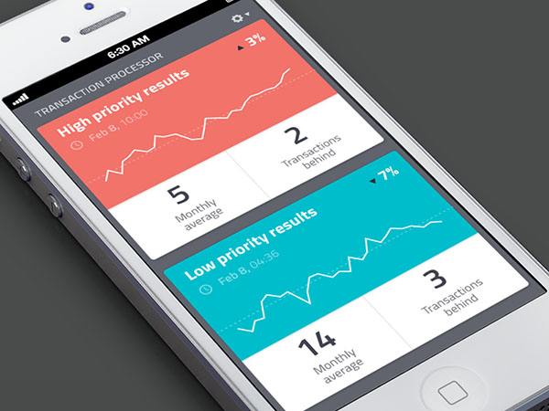
Font Usage for Mobile

Slide 49
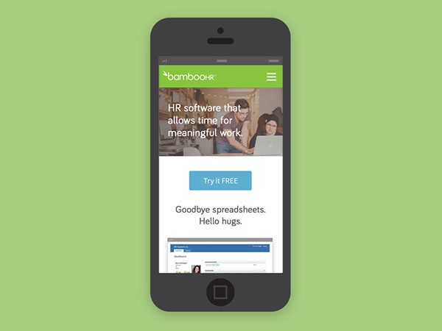
Font Usage for Mobile

Slide 50
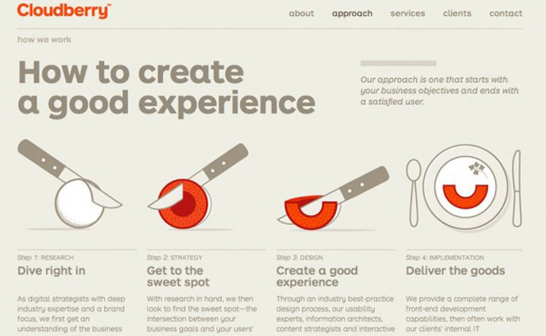
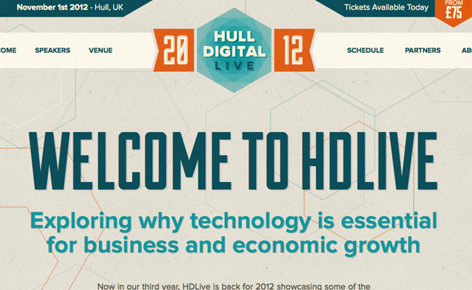
Font combinations
When planning a web project think about the message your typefaces are trying to convey.
If you haven’t, explore the categories of type and then mix typefaces from them until the design communicates what you’re trying to say.

Slide 51
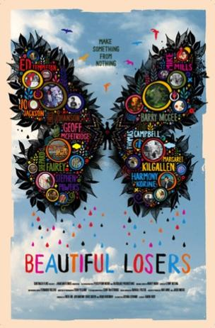

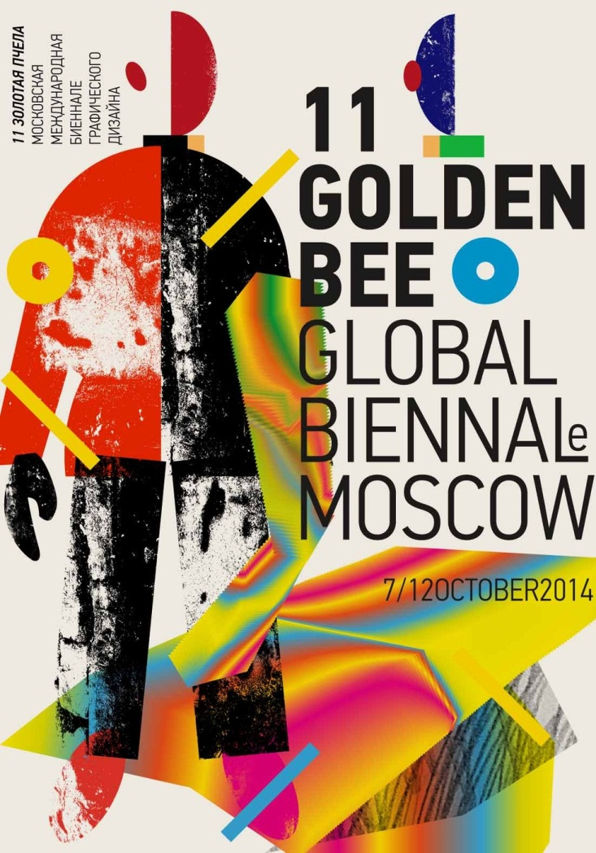
11. Typosters

Slide 52
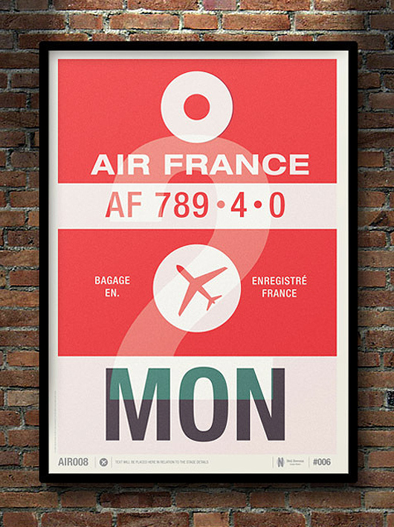
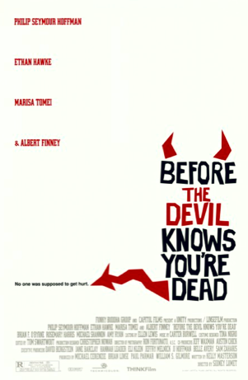
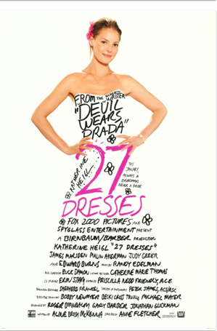
Typosters

Slide 53
Cognizant Brand Guidelines
https://groups.cognizant.com/corporate/Communications/Documents/Branding%20Guidelines/external_brand_guidelinest5.08.pdf

Slide 54
Style Guides
Google Visual Assets:
https://www.behance.net/gallery/Google-Visual-Assets-Guidelines-Part-1/9028077
Skype Brand Book:
http://issuu.com/bondo/docs/skype_brand_book_-_look?e=1099150/2586809
Parallels Style Guide :
http://www.parallels.com/fileadmin/parallels/documents/corporate/parallels_style_guide_final_apr10_2012.pdf

Slide 55
Useful Links
http://www.smashingmagazine.com/2010/05/06/50-helpful-typography-tools-and-resources/
http://welovetypography.com/
http://fontsinuse.com/
http://www.brainpickings.org/index.php/2011/08/01/10-essential-books-on-typography/
http://mashable.com/2013/05/02/typography-tools-resources/

Slide 56
Activities

Slide 57
Create demographical/ cultural aura to the below given words
BANGALORE
PUNJAB
SINGAPORE
CHENNAI
Duration: 10 minutes
Rendering type: Hand done

Slide 58
Create a character using the below alphabets
R, S, X, Z, N, J, G, Q
Duration: 10 minutes
Rendering type: Hand done

Slide 59
Create a theme for the below given word
Cognizant
Duration: 10 minutes
Rendering type: Hand done
Eg: Google doodles

Slide 60
Convey typographic expression in the below words
Help
Flexible
Friends
Glasses
Falling
Balloon
Birds
Duration: 15 minutes
Rendering type: Hand done / Digital
The words can be tweaked and you can incorporate objects with the type conveying meaning of the word.

Slide 61
TEST PAPER 25m
1. Write 2 lines on the following
San Serif b. Leading and Spacing c. Ligature
2. Explain with the help of examples the following Letters
a. Rectangular Letters
b. Round Letters
c. Wide Letters
d. Narrow Letters
3. Create a typographic logo using the word “Happy”. You should use a square serif font. The letterforms may be manipulated slightly.
5. Design a typographic post-card using the following text. Use only two colours.
Fun, Happy, Peace, New Year Greetings

Slide 62
6. Create a typographic representation combining the name of a bird with any of its qualities.
7. Write short notes on the following:
Readability of type b. Seri fonts c. Spacing
8. What are the considerations in choosing a type face for the following designs:-
Book b. Advertisement
9. How would you differentiate between legibility and readability?
10. Create a typographic logo using the word “Anim”. You should use a sanserif font. The letterforms may be manipulated slightly.

Slide 63
Thank you

